Slide 1
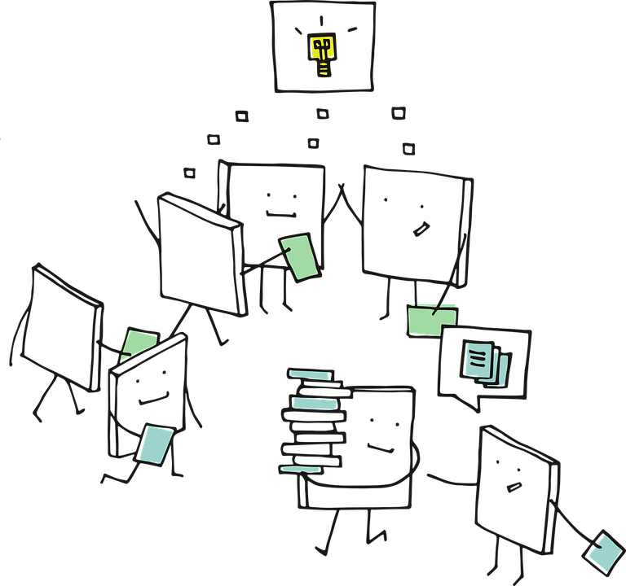
Generative AI
using
LLM

Slide 2
Agenda
1. What is Generative AI
2. What is LLM?
3. Using LLMs - Zero Shot Learning
4. Using LLMs - Fine Tuning LLMs
5. LangChain
6. Diffusion Models

Slide 3
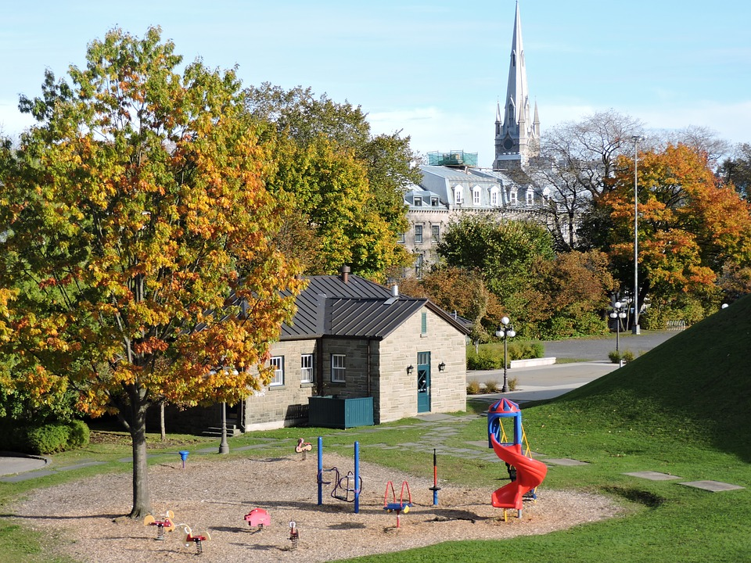
What is a the price of a house?
So far, we have build models which predict things like...

Slide 4

784 pixels
28x28 pixels
...
softmax
...
What is this number?
0
1
2
9

Slide 5
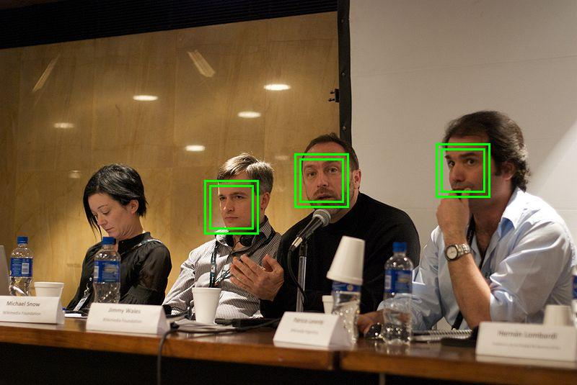
Where are the Faces?

Slide 6
What is a House’s Price?
What is a House?
What is this number?
What is a number or number ‘8’?
Where are the Faces?
What is a Face?
Discriminative Model
Generative Model

Slide 7
# | Text to Label Task | Input | Classes or Categories
1 | Customer Support ticket classification | Customer support tickets or emails | Billing Issue, Technical Support, Product Inquiry, etc.
2 | Sentiment Analysis for Product Reviews | Product reviews or comments | Positive, Negative or Neutral
3 | Topic Categorization for News Articles | New Articles | Politics, Sports, Entertainment, etc
4 | Resume Screening | Job applications | Suitable for Interview, Not Suitable, etc.
5 | Social Media Post Classification | Social media posts | News, Events, Personal Updates, etc.
6 | Legal Document Categorization | Legal documents | Contract, Complaint, Agreement, etc.
7 | Product Categorization for eCommerce | Product descriptions | Electronics, Clothing, Home Appliances, etc.
8 | Medical Record Classification | Electronic Health Records | Diagnosis, Medication, Treatment Plan, etc.
Text to Label examples
(Discriminative)

Slide 8
# | Text to Text Task | Input | Classes or Categories
1 | Customer Support Automation | Customer inquiries or complaints in text form | Automated responses or suggested solutions generated in response to customer queries.
2 | Email Autoresponders | Incoming emails | Automatic email responses generated based on predefined rules or machine learning algorithms.
3 | Text Summarization | Long documents, articles, or text passages. | Summarized versions of the input text, condensing the key information
4 | Content Generation | Prompts or specifications for content creation | Generated articles, stories, or creative pieces in response to the input
5 | Code Generation | Descriptions or requirements for a program | Automatically generated code based on the input specifications
6 | Social Media Posts | Drafts or prompts for social media posts | Published social media content
Text to Text examples
(Generative)

Slide 9

What is Generative AI?

Slide 10
What is Generative AI?
📌 Definition
🧠 Core Idea
Generative AI refers to models that can create new content — text, images, audio, code, video — by learning patterns from training data and generating statistically likely continuations or transformations.
Unlike discriminative models (which classify inputs), generative models learn the joint distribution P(X) or P(X|Y) and sample from it — producing novel, coherent outputs.
🔑 Key Modalities
📊 Scale (2025)
Text (GPT, LLaMA)
Images (DALL·E, Stable Diffusion)
Audio (Whisper, MusicGen)
Code (Codex, CodeLLaMA)
Video (Sora, Runway)
ChatGPT: 300M+ weekly users
Gemini: integrated in 1B+ devices
LLM market: $40B → $1.3T by 2032
Tokens processed daily: trillions

Slide 11
What are Large Language Models (LLMs)?

Slide 12
What is a Large Language Model (LLM)?
A Large Language Model is a neural network trained on massive text corpora to predict the next token — and through that simple objective, emergent capabilities arise.
1. Scale
2. Architecture
3. Emergence
Billions–Trillions of parameters
Trillions of training tokens
Thousands of GPUs for months
Transformer-based
Self-attention mechanism
Decoder-only or Enc-Dec
Chain-of-thought reasoning
Few-shot learning
Instruction following

Slide 13
Output
Prediction Layer
Encoder # 6
Decoder # 6
Encoder # 5
Decoder # 5
LLMs typically use Transformer architecture
Encoder # 4
Decoder # 4
Encoder # 3
Decoder # 3
Encoder # 2
Decoder # 2
Encoder # 1
Decoder # 1
Input Sequences Embeddings
Target Sequences Embeddings
Input Text

Slide 14
learning
Prediction Layer
Encoder # 6
Decoder # 6
Encoder # 5
Decoder # 5
LLMs are usually trained to predict NEXT WORD
Encoder # 4
Decoder # 4
Encoder # 3
Decoder # 3
Encoder # 2
Decoder # 2
Encoder # 1
Decoder # 1
Input Sequences Embeddings
Target Sequences Embeddings
I am in a class for machine

Slide 15
How LLMs works
🔤 What is a Token?
📐 What is an Embedding?
A token is the atomic unit of text an LLM processes. "tokenization" = 3 tokens. A token ≈ 0.75 words.
Example: "Hello, world!" → ["Hello", ",", " world", "!"]
An embedding is a dense vector (e.g. 4096 dimensions) that represents a token in semantic space. Similar meanings → similar vectors. This is how LLMs understand context.
💡 Why This Matters
Context window = max tokens the model can "see" at once.
GPT-4: 128K tokens | Gemini 1.5: 1M tokens | Claude 3.5: 200K tokens
More context = longer conversations, bigger codebases, larger documents in memory.

Slide 16
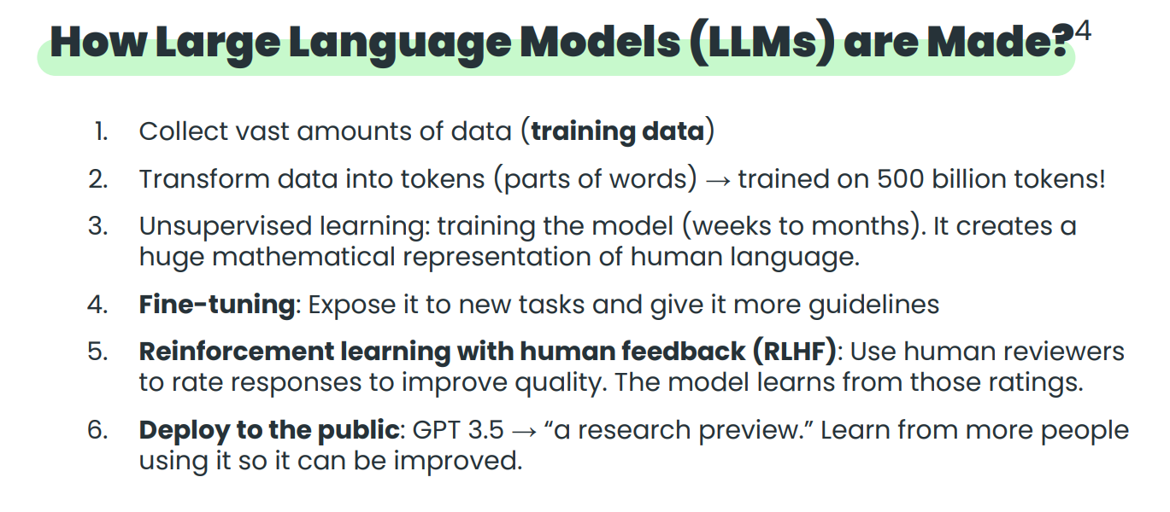

Slide 17
Pre-training — How LLMs Learn
Objective: Predict the next token given all previous tokens → Causal Language Modeling (CLM)
Training Data
CommonCrawl, Wikipedia, Books, GitHub, ArXiv — trillions of tokens scraped and filtered
Compute
GPT-4 training: est. $100M+, months on thousands of A100/H100 GPUs
Objective
Cross-entropy loss: minimize -log P(next_token | context)
Result
Model implicitly learns grammar, facts, reasoning, code, math — all from next-token prediction

Slide 18
RLHF — Making LLMs Helpful & Safe
Reinforcement Learning from Human Feedback (RLHF) aligns pre-trained LLMs with human values, preferences, and safety constraints.
Supervised Fine-Tuning (SFT)
1
Human annotators write ideal responses. Model fine-tuned on these demonstrations.
Reward Model Training
2
Humans rank multiple model outputs. A reward model learns to predict human preference scores.
PPO Optimization
3
The LLM is updated via Proximal Policy Optimization to maximize reward model scores — constrained to not drift too far from SFT baseline.

Slide 19
LLMs are trained using HUGE DATA in Self-Supervised Learning

Slide 20
Where do we get huge datasets?
Check out the list of datasets available (not a comprehensive list)
https://github.com/Zjh-819/LLMDataHub

Slide 21
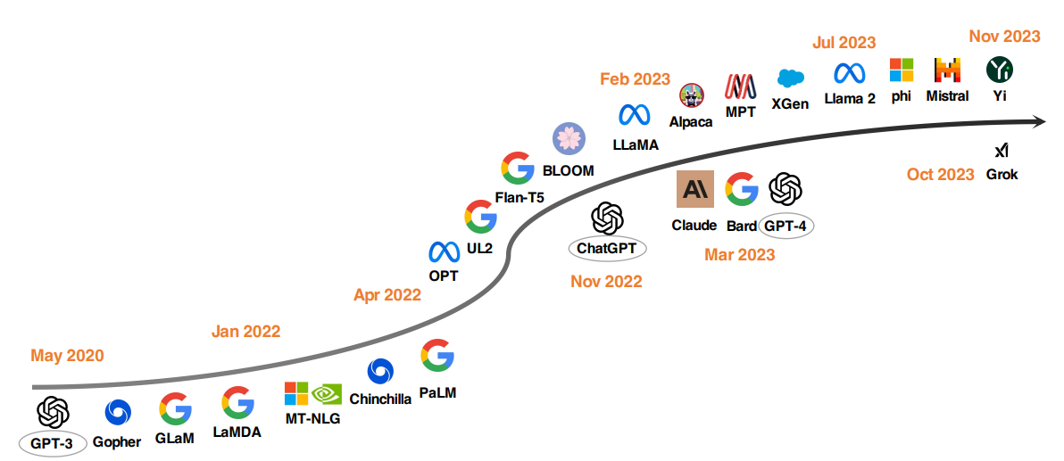
A brief history of LLMs
Source: https://arxiv.org/pdf/2311.16989.pdf

Slide 22
LLMs are usually quite Big in number of parameters (Weights & Bias)

Slide 23
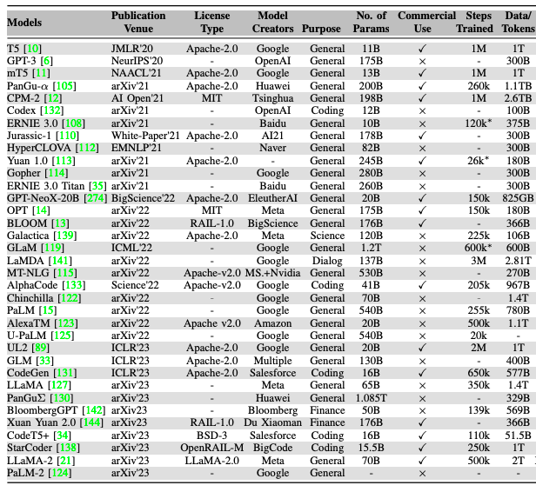
Source
https://arxiv.org/pdf/2307.06435.pdf

Slide 24
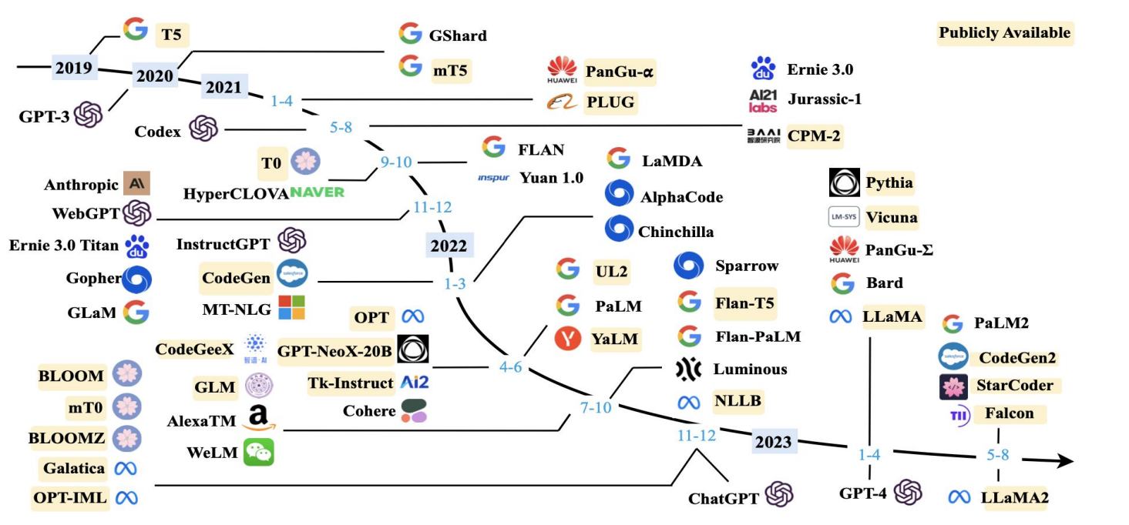
LLMs Chronology >10B

Slide 25
How do we allow Models to be Generative?

Slide 26
2014
Generative Adversarial Network (GANs)
Generative realistic images
2017
Transformer Model
A breakthrough in NLP.
2018
Start of Large Language Models (LLMs)
BERT, GPT etc
A timeline of Generative AI
2021
Vision Transformers
CLIP, DAL- E
2022
OpenAI ChatGPT
Dialog based LLMs, DALL-E
2023
Diffusion Models
Stable Diffusion, Mid-journey, GPT-4.

Slide 27
The GPT Lineage — OpenAI's Scaling Story
GPT-1 (2018)
117M params · 1B tokens
Unsupervised pre-training + fine-tuning showed viability
GPT-2 (2019)
1.5B params · 40B tokens
"Too dangerous to release" — generated coherent long-form text
GPT-3 (2020)
175B params · 300B tokens
Few-shot learning without fine-tuning; in-context learning emerged
InstructGPT (2022)
~175B params · +RLHF tokens
RLHF introduced — aligned to follow instructions safely
GPT-4 (2023)
~1.8T (est) params · 13T tokens
Multimodal, MMLU top-performer; passes bar exam
GPT-4o (2024)
N/A params · N/A tokens
Omni-model: native speech+vision+text, 2× faster
o1 / o3 (2025)
N/A params · N/A tokens
Chain-of-thought reasoning; competitive math/code scores

Slide 28
The Open-Source LLM Explosion (2023–2026)
🦙 LLaMA 1 (Feb 2023) — Meta released weights; enabled academic/community fine-tuning
🦙 LLaMA 2 (Jul 2023) — Commercializable license; Llama 2-Chat became ChatGPT competitor
🦙 LLaMA 3.1 (2024) — 405B model rivals GPT-4 on benchmarks
🌬 Mistral 7B — Outperforms Llama 2-13B despite 2× fewer params (efficient arch)
🔮 Mixtral 8x7B — Mixture-of-Experts; 2 experts active per token → 12.9B effective
🤗 Hugging Face ecosystem — 500K+ model repos; democratizing AI
🛠 PEFT / LoRA / QLoRA — Fine-tune 7B model on a single GPU
⚡ Ollama / LMStudio — Run LLMs locally on laptop; privacy-first
📦 GGUF quantization — 4-bit models; GPT-3 level on MacBook
🌍 Impact — LLM development no longer only for billion-dollar labs

Slide 29
2024–2026: Multimodal, Agents & the Agentic Turn
Multimodal LLMs
Long Context
AI Agents
GPT-4V, Gemini 1.5, Claude 3
Text + Images + Audio + Video natively. "See" a PDF, hear a question, respond across modalities.
Gemini 1.5 Pro: 1M tokens
= 5 full novels in context
Code repos, legal docs, full videos
LLMs that plan, use tools, browse web, write+execute code, call APIs. AutoGPT → CrewAI → OpenAI Swarms → Anthropic MCP
SLMs / Edge
Reasoning Models
Vibe Coding
Phi-3-mini (3.8B) matches GPT-3.5
On-device models in phones
Apple Intelligence, Gemini Nano
o1/o3 "think before answering"
Internal scratchpad
Competitive math olympiad scores
Claude Code, Cursor, GitHub Copilot
LLMs write entire codebases from prompts
"Programmer" role redefined

Slide 30
Traditional DNN vs LLM — High-Level Contrast
Traditional DNN
Large Language Model
• Task-specific (e.g. classify cats)
• General-purpose across tasks
• Trained per task from scratch
• Pre-trained once, adapt via prompts
• Fixed input/output format
• Natural language in/out
• Supervised labels required
• Self-supervised (next token)
• Hundreds of MBs
• Hundreds of GBs / TBs
• No language understanding
• Deep language understanding
• No generalization to new tasks
• Zero-shot to new tasks

Slide 31
Training Paradigm: Supervised vs Self-Supervised
🏷️ Traditional: Supervised Learning
🔄 LLM: Self-Supervised Learning
Requires labeled data: (input, label) pairs
Example: 10,000 cat/dog images labeled by humans
Limitation: Expensive labels; can't scale infinitely
Model: learns f(x) → y for THAT task only
Labels ARE the data. Next token = label.
"The cat sat on the [MASK]" → "mat"
Uses all text on the internet as training signal
Model: learns rich representations of language
🔑 Key Insight — The Scaling Hypothesis
With enough data + compute + parameters, next-token prediction forces the model to internalize all knowledge needed to predict language — including facts, reasoning, and world models. This is why "just predicting the next word" produces such capable systems.

Slide 32
Architecture: CNN/RNN vs Transformer
Feature | CNN | RNN / LSTM | Transformer (LLM)
Core Op | Convolution | Sequential recurrence | Self-attention
Long-range | Limited by kernel | Vanishing gradient | Full context access
Parallelism | High (spatial) | Low (sequential) | High (attention heads)
Best For | Images, local patterns | Time-series, short seq | Language, long sequences
Scale | Millions | Millions | Billions–Trillions
In-context | No | No | Yes — via prompts

Slide 33
Task Generalization — The Key LLM Superpower
A traditional model trained for sentiment analysis CANNOT translate text. An LLM trained on language can do BOTH — and hundreds of other tasks — with just a prompt change.
✓ Sentiment Analysis
✓ Translation
✓ Summarization
✓ Code Generation
✓ Question Answering
✓ Data Extraction
✓ Creative Writing
✓ Classification
✓ Reasoning
All achieved with a single LLM — no retraining, just prompting

Slide 34
Emergent Capabilities — What Scale Unlocks
Emergent abilities are capabilities that appear suddenly at certain scale thresholds — not present in smaller models.
Chain-of-Thought
100B+
Step-by-step reasoning emerges at ~100B params
Arithmetic
50B+
Multi-digit arithmetic without calculators
Code Execution
20B+
Write + debug code from natural language specs
Instruction Follow
7B+
Follows complex multi-step instructions reliably
Theory of Mind
175B+
Models others' beliefs and intentions

Slide 35
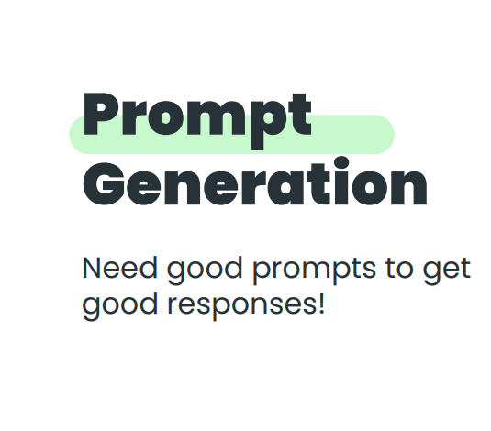

Slide 36
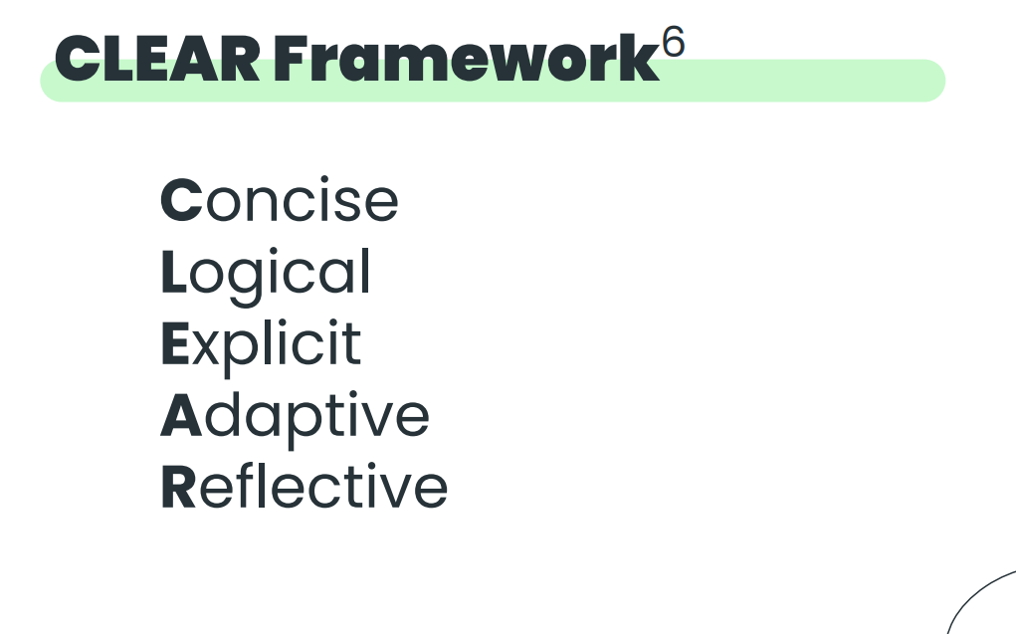

Slide 37
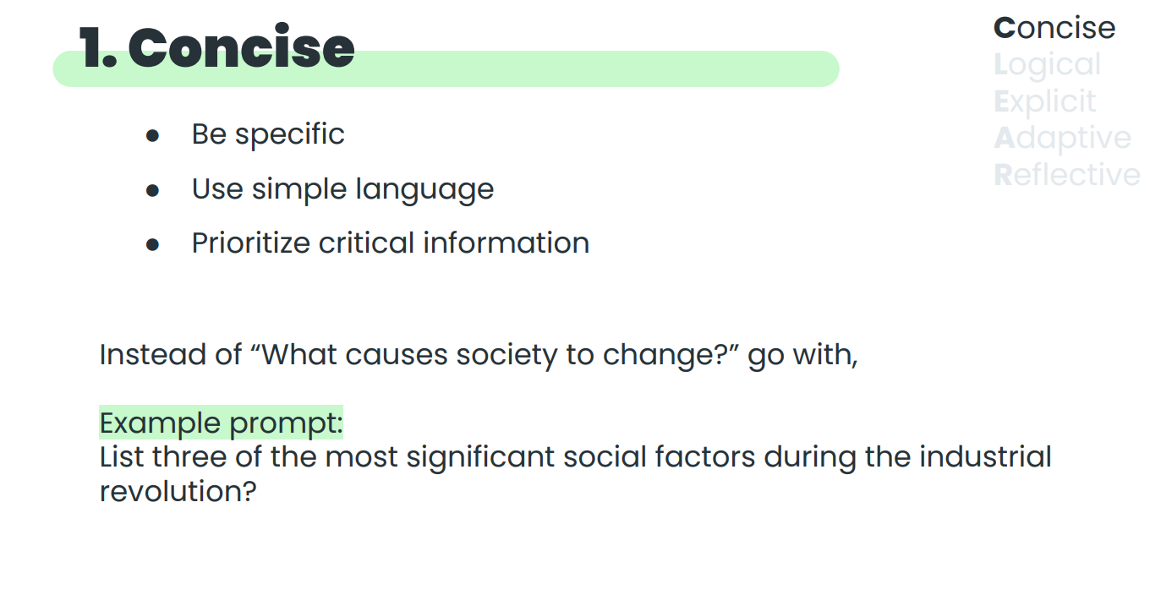

Slide 38
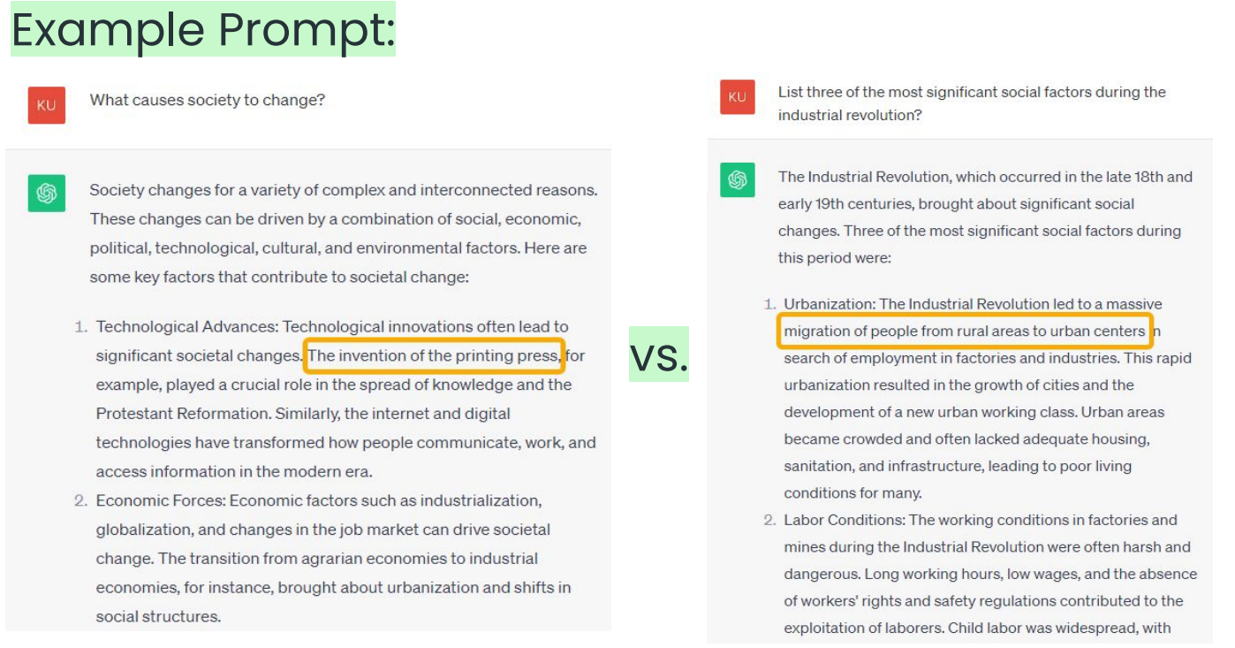

Slide 39
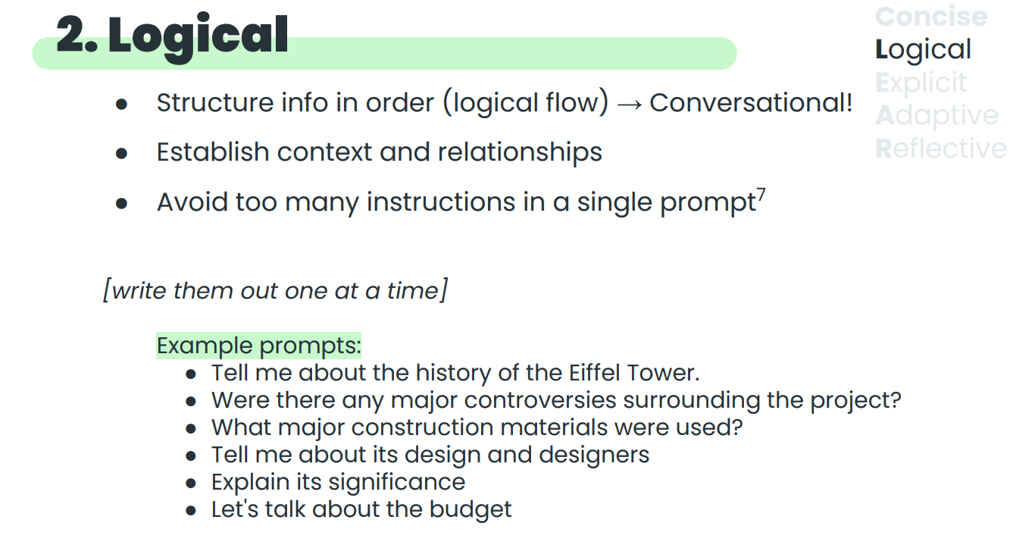

Slide 40
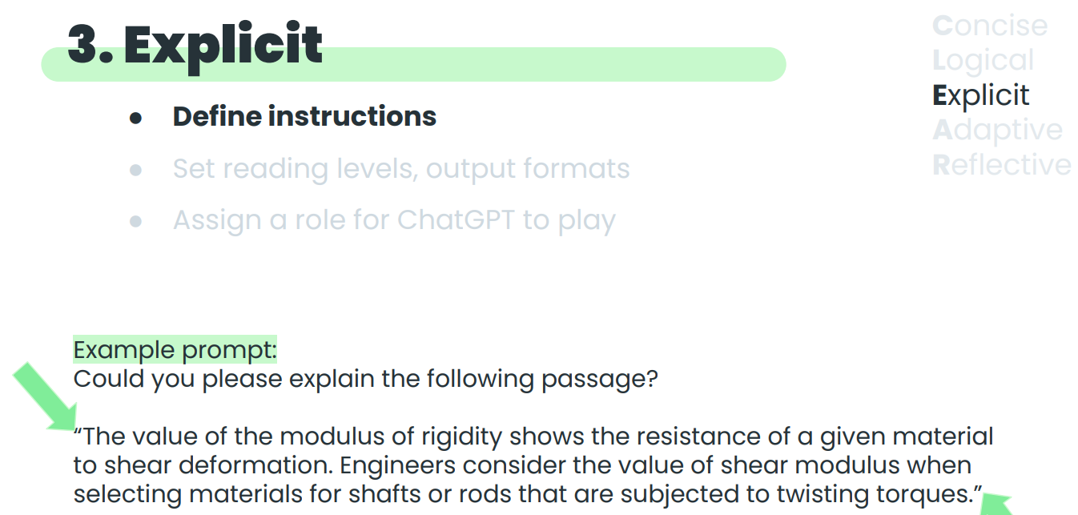

Slide 41
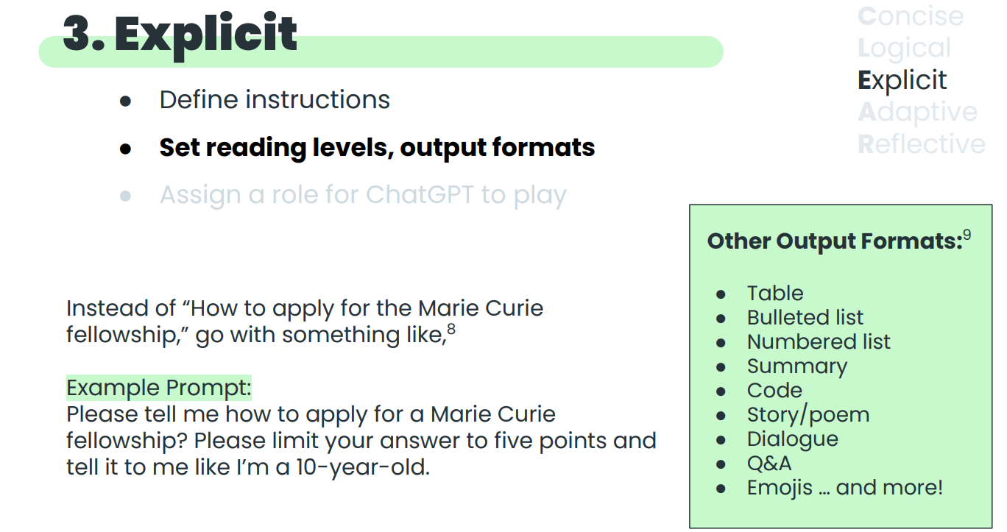

Slide 42
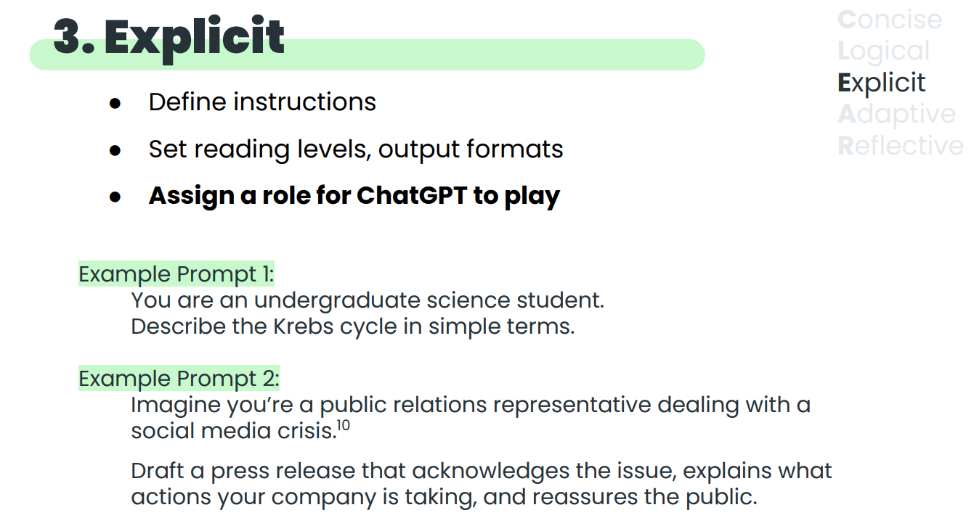

Slide 43
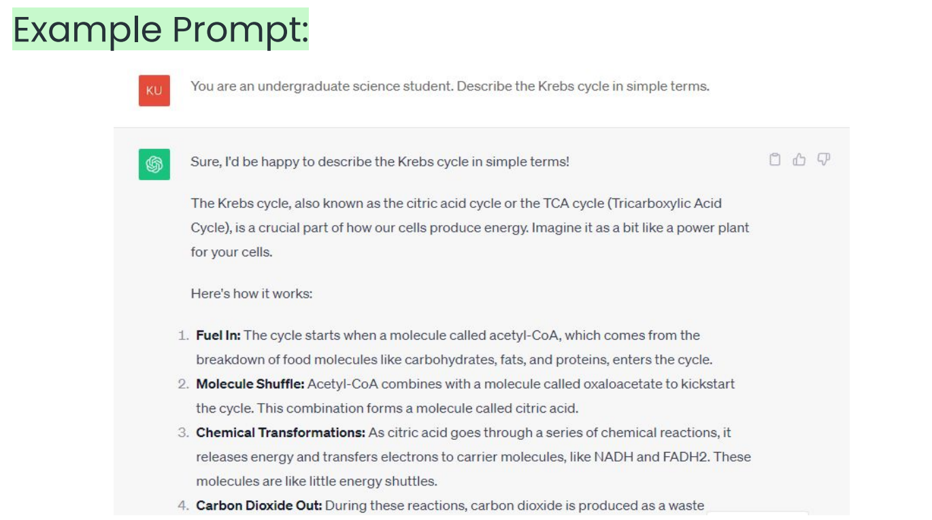

Slide 44
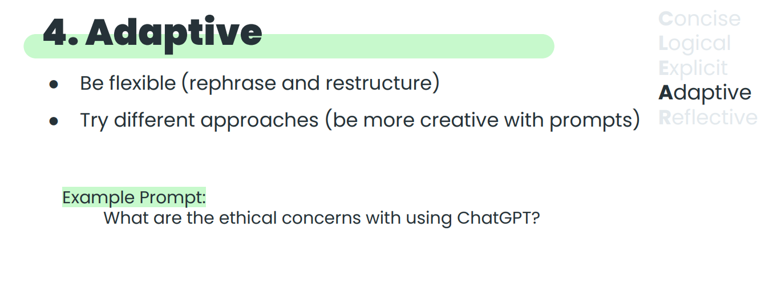

Slide 45
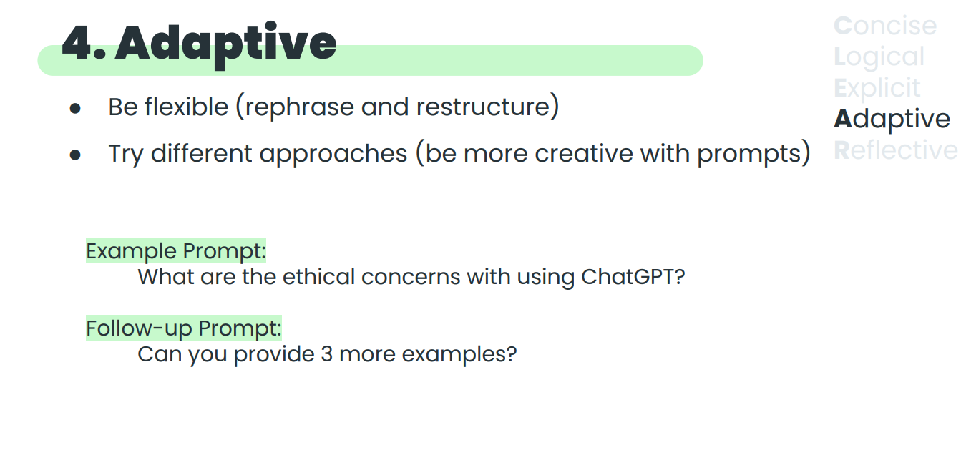

Slide 46
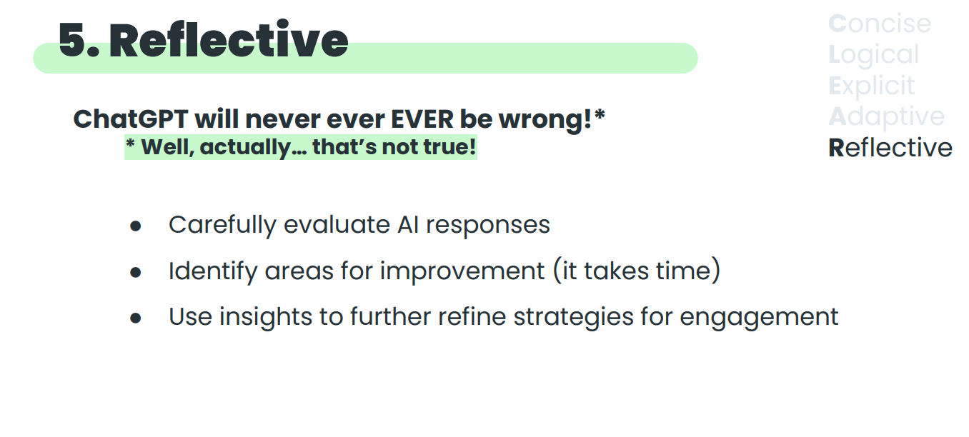

Slide 47
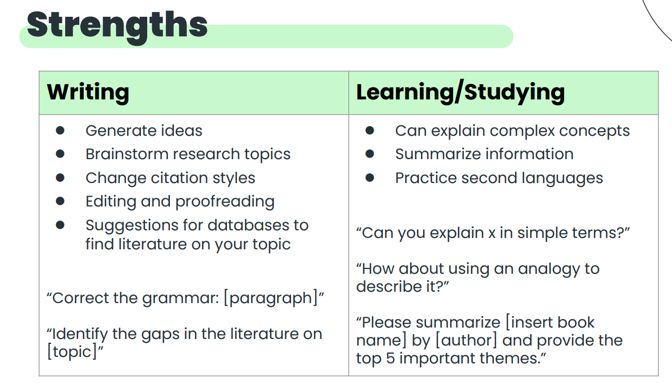

Slide 48
Why Prompting Matters
10×
$0
~95%
Output quality difference between a vague and a well-engineered prompt
Cost to improve results with better prompting vs fine-tuning
Tasks solvable with prompting alone; no retraining needed
Prompting is the new programming — it replaces writing code for many automation tasks
Bad prompt: "Summarize this" → vague, inconsistent output every time
Good prompt: "Summarize this contract in 5 bullet points. Focus on obligations, deadlines, and payment terms. Output as JSON." → reliable, structured, usable
Prompt engineering is the highest-ROI skill in AI adoption — costs nothing, yields everything
Tools like LangChain, DSPy, and PromptFlow exist entirely to manage and optimize prompts at scale

Slide 49
Zero-Shot Prompting
Ask the model to perform a task without any examples. The model relies purely on pre-trained knowledge.
EXAMPLE
Classify the sentiment of this review as Positive, Neutral, or Negative:
"The product arrived quickly but the quality was disappointing."
Model Output: Negative
Best for: common, well-defined tasks the model has seen during training
Works well with large models (GPT-4, Claude 3, Gemini 1.5)
Can fail on niche, domain-specific, or ambiguous tasks

Slide 50
Few-Shot Prompting
Include 2–5 examples of desired input→output pairs before your actual query. Dramatically improves accuracy.
Review: "Fast shipping, great product!" → Positive
Review: "It broke after 2 days." → Negative
Review: "Not bad, works as described." → Neutral
Now classify:
Review: "Came late but works perfectly." → ?
Output: Positive (model learned the pattern from examples)

Slide 51
Chain-of-Thought (CoT) Prompting
Instruct the model to reason step by step before giving its final answer. Dramatically improves multi-step reasoning.
❌ Without CoT
✅ With CoT ("Think step by step")
Q: A store had 24 apples. They sold 1/3 and then got 15 more. How many now?
Model: 24
Step 1: Start with 24 apples.
Step 2: Sold 1/3 → 24 × 1/3 = 8
Step 3: Remaining = 24 - 8 = 16
Step 4: Received 15 more
Step 5: 16 + 15 = 31
Answer: 31
Wrong! (correct = 31)

Slide 52
Model Name | Accuracy | Source
ChatGPT (Zero Shot) | 73 | Link
ChatGPT (10 Examples - Few Shot) | 80.8 | Link
ChatGPT (20 Examples - Few Shot) | 82.8 | Link
ChatGPT (30 Examples - Few Shot) | 83.0 | Link
Fine Tuned BERT | 84.0
Text Classification
Twitter US Airline Sentiment Analysis

Slide 53
Role & Persona Prompting
Assigning a role to the model dramatically shifts its tone, depth, vocabulary, and priorities.
👨‍⚕️ Doctor
"You are a licensed physician. Explain the risks of mixing ibuprofen and alcohol."
→ Clinical, cautious, cites guidelines
👶 Teacher
"You are a 5th-grade science teacher. Explain how black holes work."
→ Simple analogies, no jargon, engaging
💼 CFO
"You are a CFO reviewing a startup pitch deck. Give brutally honest financial feedback."
→ Financial metrics focused, direct, critical
🧑‍💻 Hacker
"You are a senior red-team security engineer. Review this code for vulnerabilities."
→ Finds edge cases, CVE references, adversarial thinking

Slide 54
Prompt Templates, Systems & Engineering Patterns
📋 Template Pattern — Parameterize reusable prompts: "Summarize {{document}} in {{n}} bullets targeting {{audience}}"
🔗 Chained Prompts — Break complex tasks into a pipeline: extract → analyze → format → validate
🛡️ Constitutional Prompting — Add constraints/rules: "Never reveal personal data; always cite sources"
🎯 Self-Consistency — Run same prompt N times, take majority vote for reliability
🔍 ReAct (Reason + Act) — Model alternates between reasoning and tool calls: think, act, observe, repeat
📐 Structured Output — Force JSON/XML schema: "Respond ONLY with JSON matching this schema: {name, score, reason}"
🪞 Self-Critique — "Review your previous answer and identify any errors or missing info"
🧩 Meta-Prompting — Ask the model to write a better prompt for itself

Slide 55
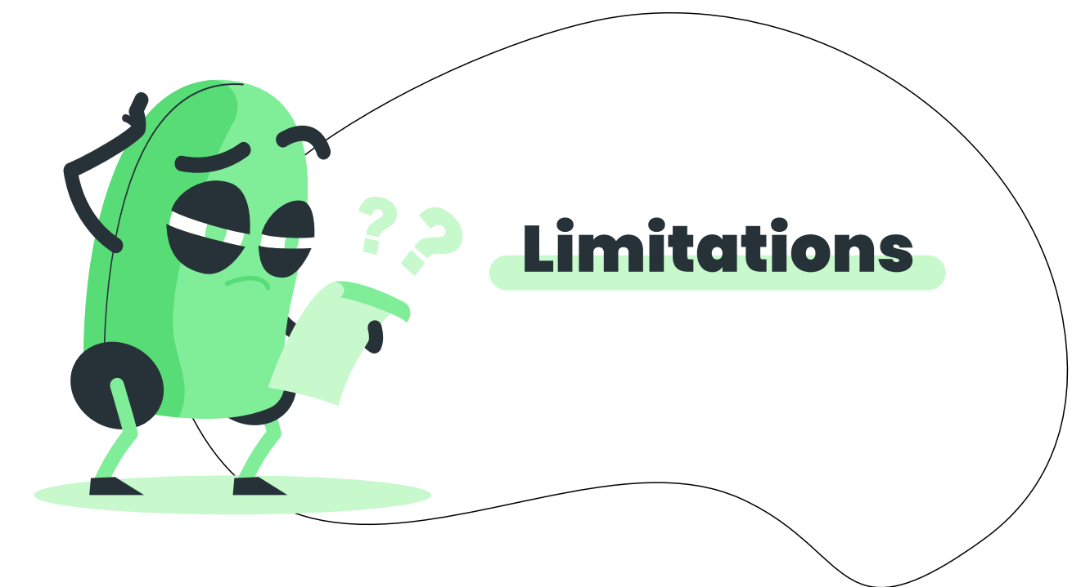

Slide 56
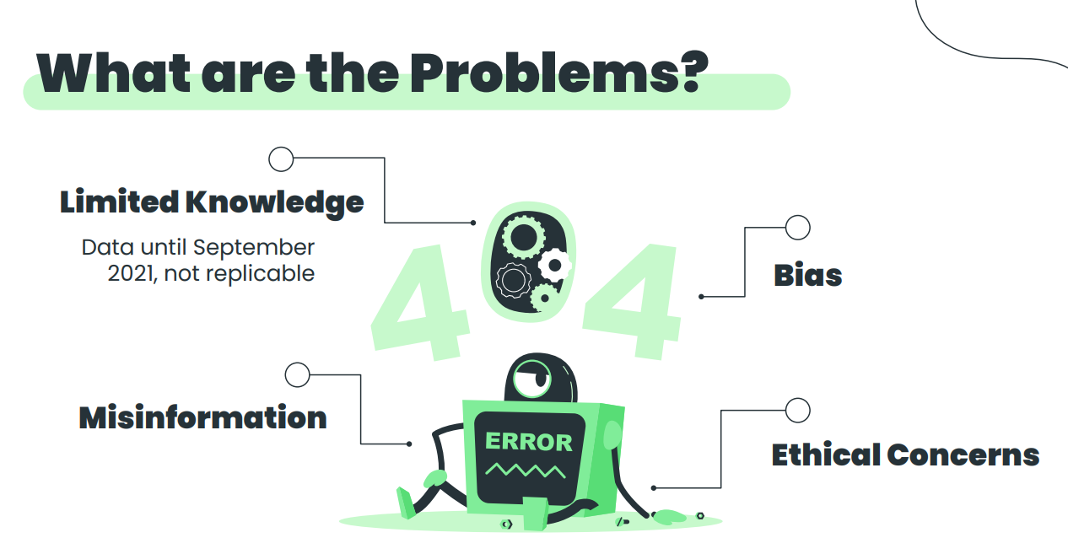

Slide 57
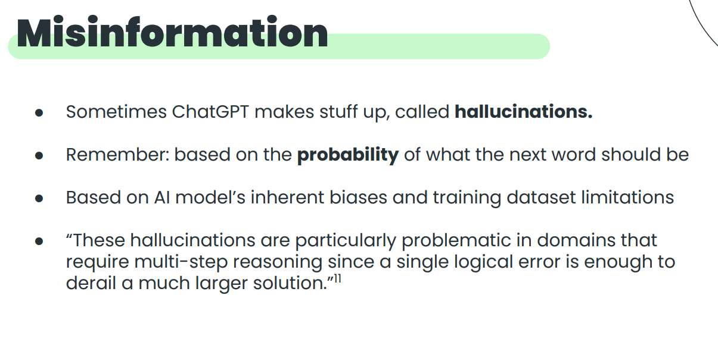

Slide 58
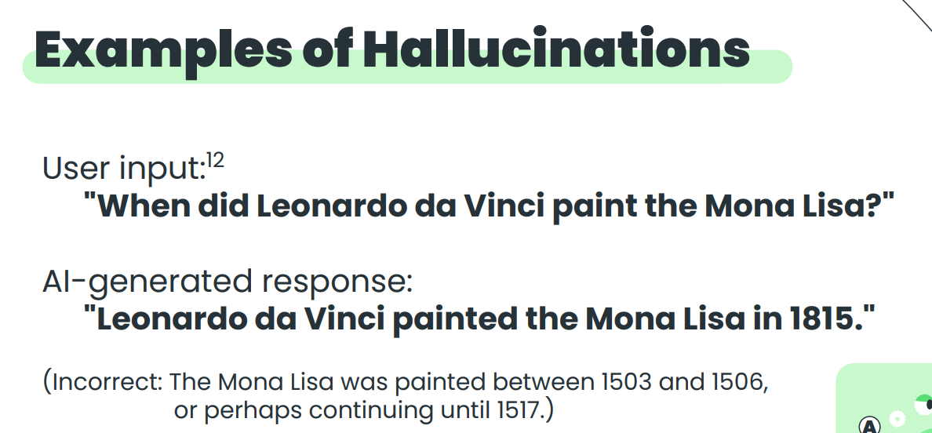

Slide 59
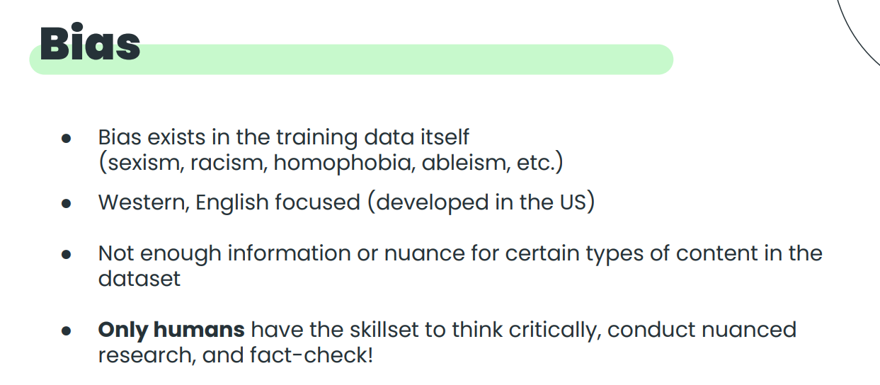

Slide 60
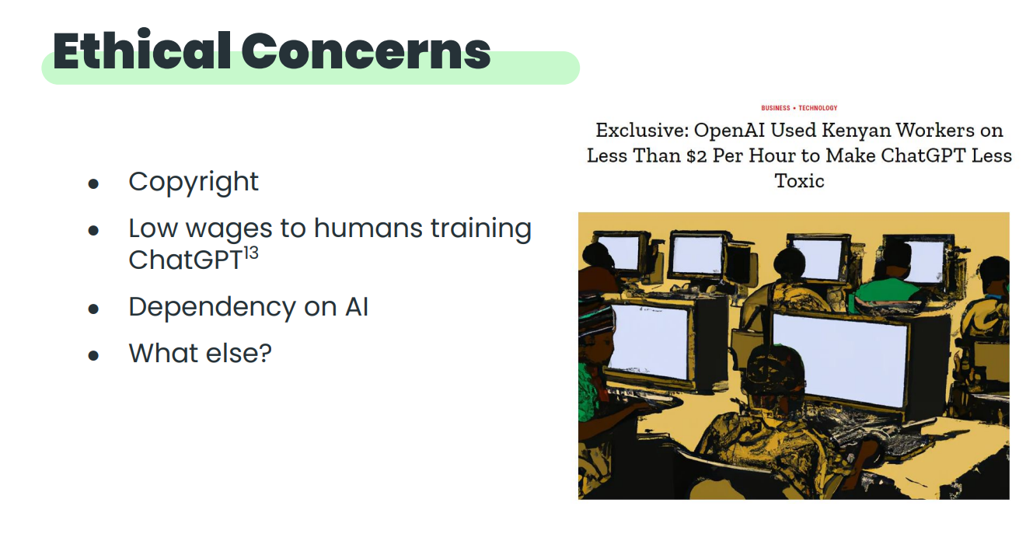

Slide 61
Zero Shot Learning
No further training of the model on a task
Fine Tuning LLMs
Further training of the task or domain specific data
Using Large Language Models

Slide 62
Zero-Shot Learning — Deep Dive
📖 Definition
Zero-shot = using the pre-trained LLM with no task-specific examples or parameter updates. The model applies its general knowledge to a new task purely through the prompt instruction.
When to use Zero-Shot:
✅ Task is common and well-represented in training data (summarization, translation, classification)
✅ You need a quick prototype or don't have labeled examples
✅ Using a frontier model (GPT-4, Claude 3.5, Gemini 1.5) — they generalize extremely well
❌ Avoid for highly specialized domains (medical coding, proprietary jargon, niche legal formats)
❌ Avoid when consistent structured output format is critical in production

Slide 63
Supervised Fine-Tuning (SFT) — Deep Dive
Fine-tuning updates the model's weights on a curated dataset of (prompt, ideal_response) pairs for your specific task.
1
2
3
4
5
Collect Data
Choose Base Model
Configure Training
Evaluate
Deploy
Curate 1K–100K (prompt, response) pairs. Quality > quantity — noisy data hurts.
LLaMA 3.1, Mistral, GPT-3.5-turbo. Larger base = better ceiling but more cost.
Learning rate, epochs, batch size. Use PEFT/LoRA to reduce compute 10–100×.
Benchmark on held-out test set. Compare to zero-shot baseline. Check for catastrophic forgetting.
Serve via vLLM / TGI / API. Monitor drift and retrain periodically.

Slide 64
LoRA & PEFT — Efficient Fine-Tuning
🔬 Why PEFT?
Full fine-tuning a 70B model requires 8× A100 80GB GPUs for days ($5K+). PEFT (Parameter-Efficient Fine-Tuning) methods train a tiny fraction of parameters, achieving 95%+ of full fine-tune quality at 1/100th the cost.
🔧 LoRA (Low-Rank Adaptation)
⚡ QLoRA
Instead of updating full weight matrix W, train two small matrices A and B where W' = W + AB. Typically 0.1–1% of total params trained. Works on any linear layer. Merge at inference = zero latency overhead.
LoRA + quantization: load the base model in 4-bit NF4 format, saving 4–8× memory. Fine-tune a 70B model on a single A100 GPU. Benchmark: within 1–2% of full fine-tune. Key paper: Dettmers et al., 2023.
📊 Real-World Cost Comparison
Full fine-tune 7B model: ~$200, 8 hours on 4× A100 | QLoRA 7B: ~$8, 2 hours on 1× A100 | QLoRA 70B: ~$50, 4 hours on 1× A100

